Slide 1

IoA Eco-Tourism Management Tool
Project Overview 4/12/2022

Slide 2
Project Overview
Web + Mobile application that will help community tour operators collect, track and store tourist related health and contact information to enforce local COVID protocols, and log reservations accordingly.

Slide 3
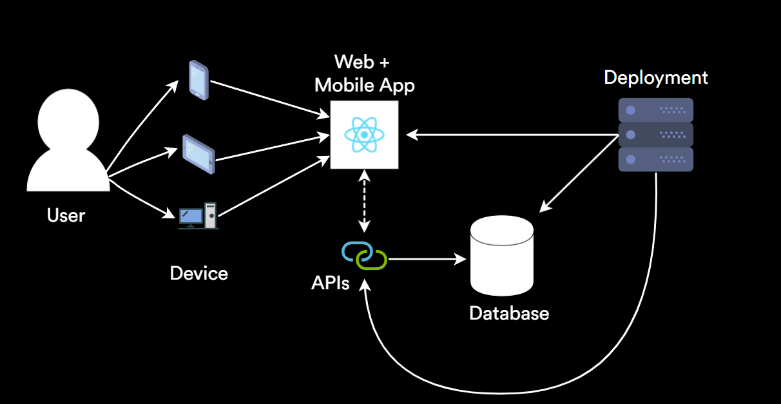
Big Picture

Slide 4
Eco-Tourism Management Tool
Frontend Team
Project Overview 4/12/2022

Slide 5



High Level Project Specifications
ReactJS and React Native web + mobile framework
Receive User Input
Customizable look and feel
Multi-Lingual Support

Slide 6
MVP Goals - Frontend and Mobile
Simple online questionnaire for end user traveler, accessible via web browser, tablet, and mobile devices.
Customized White Label functionality to include look and feel/branding for specific tour operator.
Generate a QR Code to be scanned upon arrival for tour.
Multi-language functionality: English; Spanish & French (primary North American languages)

Slide 7
Timeline
Week 3 | Design UI/prototype and discuss database specifications with backend team
Week 4 - Week 7 | Code Sprint - Implement working front end MVP (UI/UX, Questionnaire, QR Codes)
Week 8 | UX tests & feedback collection
Week 9-10 | Fine-tuning based on feedback, integration testing of the application with back end
Week 11 | Wrap up, Video & Paper presentation
Notes:
Organize specifications over what database to use/ were to host database
Meet with Frontend team to discuss what their needs are in terms of the backend API

Slide 8
Eco-Tourism Management Tool
Backend Team
Project Overview 4/12/2022

Slide 9
High Level Project Specifications
Create searchable database containing information on travelers, booking dates, and COVID health statuses.
Create working API that is available for Frontend Team to utilize in their user interface.
Implement security features into backend for secure data access.

Slide 10
MVP Goals - Backend Administration
Backend support for White Label Functionality for branding specific tour operators.
Searchable Database of travelers, booking dates, COVID Health Status.
API for administrator to assign traveler to specific tour operators.
API support for implementing COVID protocols.
API for secure web and mobile access.

Slide 11
Timeline
Week 3 | Requirement Analysis with Frontend team to organize specifications over what database to use, and where to host the database.
Week 4 - Week 5 | Designing database schemas and setting up databases - local or cloud?
Week 6 - Week 7 | Start Implementing the API functions
Week 8 - Week 9 | Security Analysis & Features implementation
Week 10 | High Level testing of the application with Front End
Week 11 | Wrap up, Video & Paper presentation

Slide 12
Thank you!

